Slide 1
Training Webinar
January 17, 2024
Notes:
Register here: https://www.surveymonkey.com/r/K8QX2TM

Slide 2
Agenda & Speakers
Angela Jiskoot
Adam Lounsbury
Kevin Koester
Volunteer Iowa Commission Chair
Executive Director, Volunteer Iowa
Volunteer Iowa staff
Rebecca Gernes
Volunteer Iowa Commissioner
Iowa State Representative, 38th District (2009-2018)
Introductions
Day at the Capitol Overview & FAQs
How & Why we ask for your participation
Tips & Guidance for connecting with legislators
Volunteer Iowa Policy Priorities
Q & A

Slide 3
Video

Slide 4
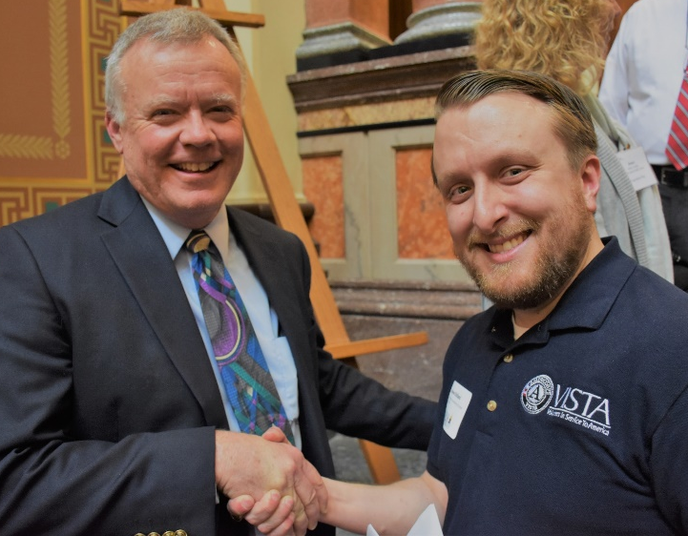
Day at the Capitol Overview
What: participants meet in person or virtually with legislators to educate and engage them with the mission and policy initiatives of Volunteer Iowa.
Why?
Highlight the importance of service & volunteering in Iowa
Build legislators’ awareness of policy issues important for expanding our sector
Provide a venue for Volunteer Iowa programs to connect with their local legislators
Notes:
Volunteer Iowa provides a wide range of programming, funding, and training related to service and volunteerism that has an impact across the entire state (can point out some examples of people who are signed into the call). But, oftentimes our role is “behind the scenes” and funders may not understand how the programs they see in their communities are supported by our work.
SO, we (like many others) host a Day at the Capitol as a way to build awareness among legislators about the importance of volunteers & service in Iowa and the current public policy issues that affect volunteerism.
Hosting this day helps us provide a unified message to legislators while also allowing participants to share their unique contributions. We want to attract attention to Iowa nonprofits and volunteer programs to help legislators understand what’s being accomplished by volunteers and the critical services that could be lost without assistance from dedicated volunteers.

Slide 5
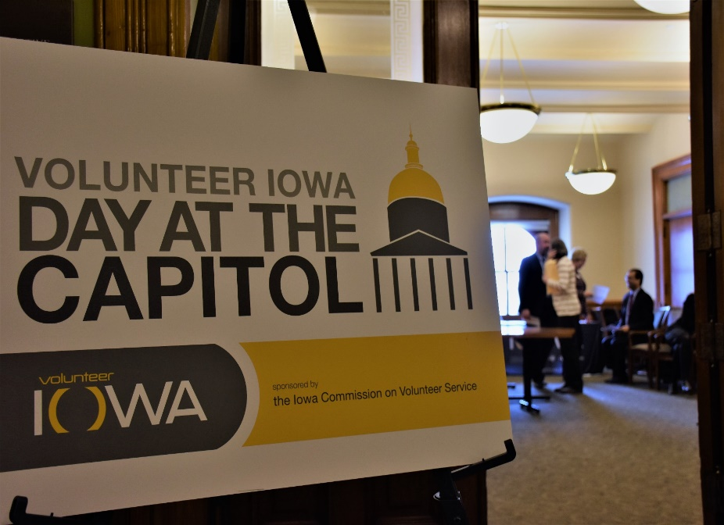
When and Who
February 1, 2024
11 am-1 pm
Volunteer Iowa Table in South Rotunda
Meetings with legislators can take place throughout the day, as convenient for you and your elected officials
Unable to attend in person? Schedule a phone call or virtual meeting
This is only ONE contact in relationship building with your legislator
Register here!
WHO SHOULD PARTICIPATE: Any staff member, participant, or supporter of your program who can speak to the value of Volunteer Iowa to your program or organization.
Notes:
participation is not limited to this ONE day.
Virtual opportunities on Feb. 1 or anytime around that day!
Make sure that everyone who plans to participate from your program is registered! This is important to track to measure our outreach.

Slide 6
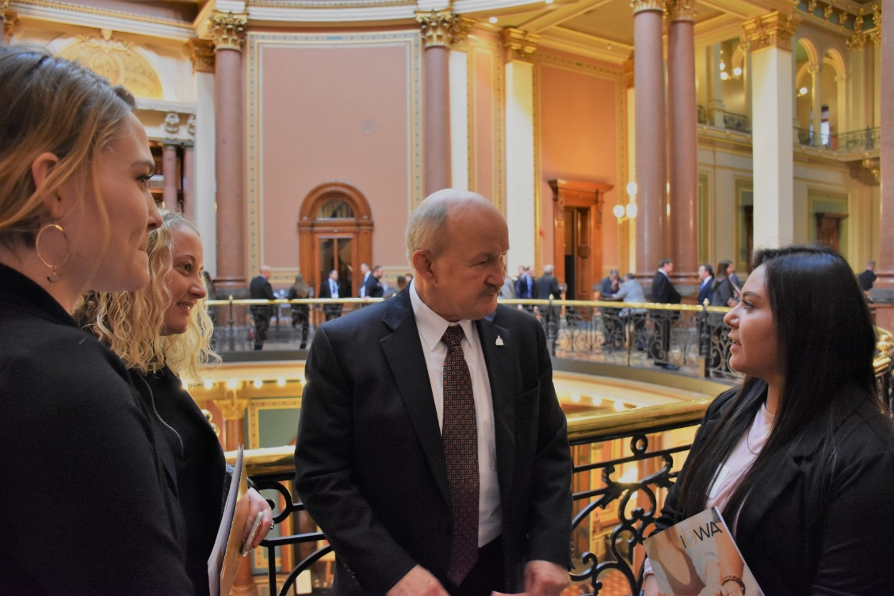
Why take part at the Day at the Capitol?
If YOU don’t share your priorities with legislators, who will?
Advocacy is one of the most important methods for organizations to help achieve results
Legislators need to understand your organization and your issues/clients to make good policy decisions
Notes:
people may feel hesitant to engage with policy makers (Perceived Barriers):
Confusion/fear of laws
Lack of board and leadership support
Lack of staff time and expertise

Slide 7
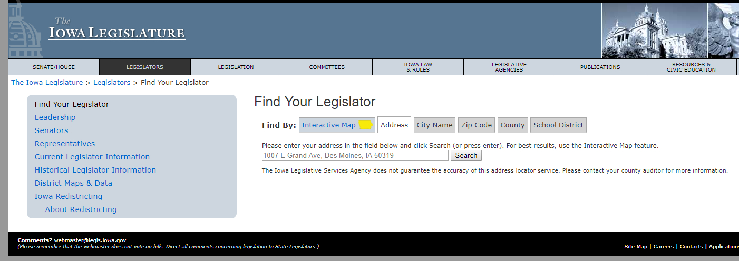
Your Role as a Participant
Before Feb 1:
Set up in-person, phone, or video meetings in advance of the day: https://www.legis.iowa.gov/legislators/find
Reserve a program table with Volunteer Iowa
Review the toolkit, talking points, and other resources provided by Volunteer Iowa
Notes:
Use the toolkit to guide your preparation for the day
Contact your legislators to set up a meeting – the toolkit has a template email you can modify for your program
Legislators are extremely busy during session– it’s very unlikely you will be able to connect with them on our Day if you haven’t reached out in advance. Inviting your legislators is the single most important thing you can do to ensure they know you want to talk to them.
If you can’t be at the Capitol or meet on Feb. 1, ask for a meeting time on another day or a virtual meeting.

Slide 8
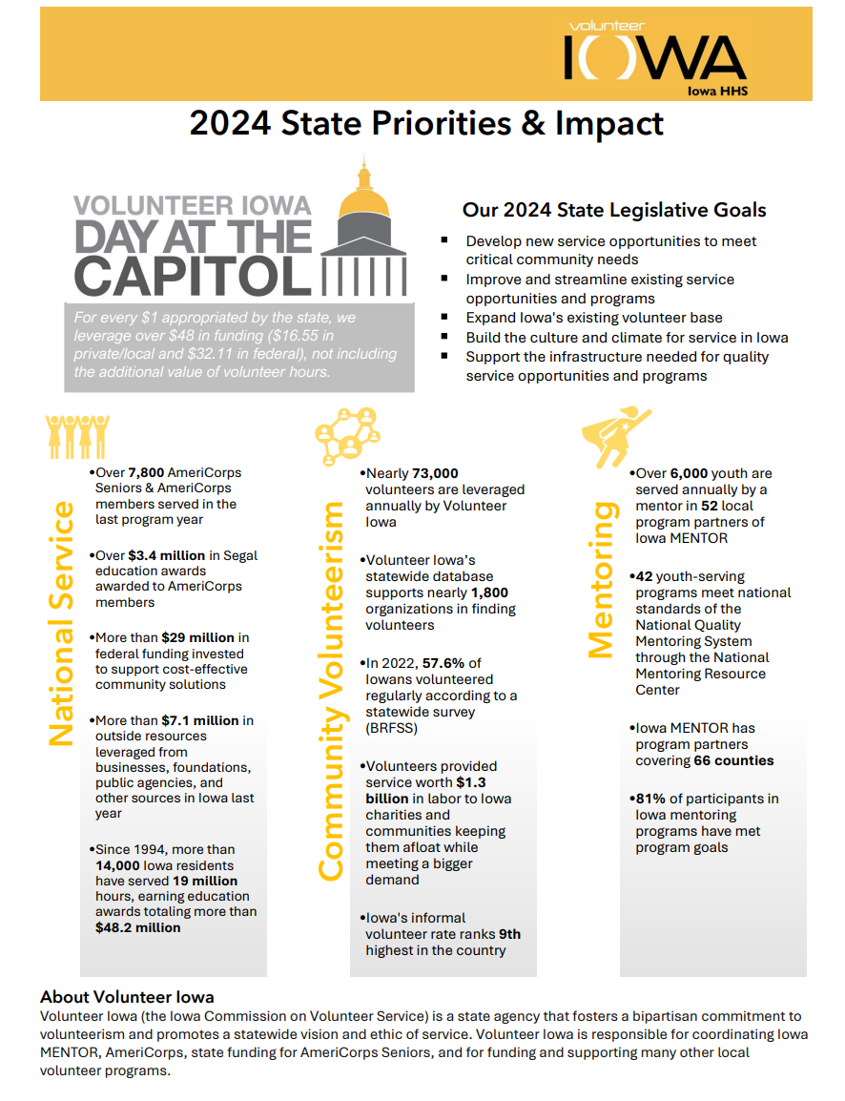
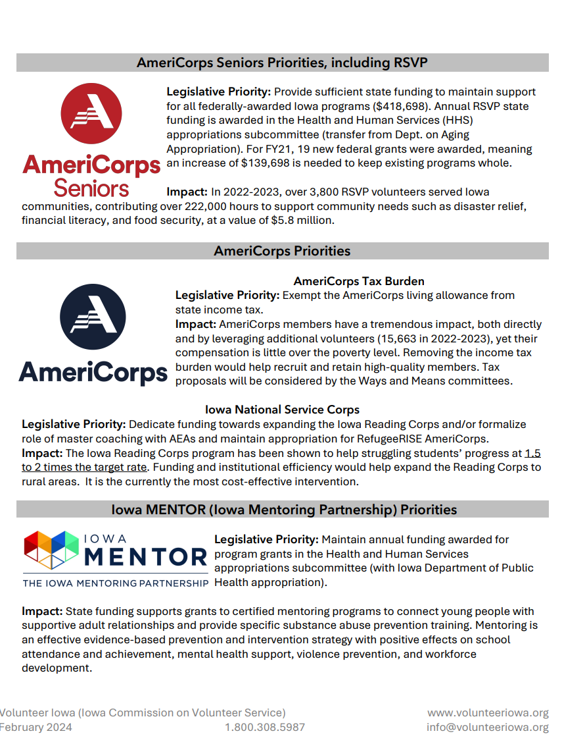
On Feb 1: 1. Hold the meeting(s) with your legislators 2. Share Volunteer Iowa’s State Priorities and Impact Handout 3. Celebrate your participation on social media, your website, local news, etc.
Your Role as a Participant
Notes:
Prepare to talk with legislators about how volunteers and service members assist your organization in fulfilling your mission!
This is the handout we’ll have ready for you to give to your legislators- please review the policies and data points relevant to YOUR program to share with policy makers

Slide 9
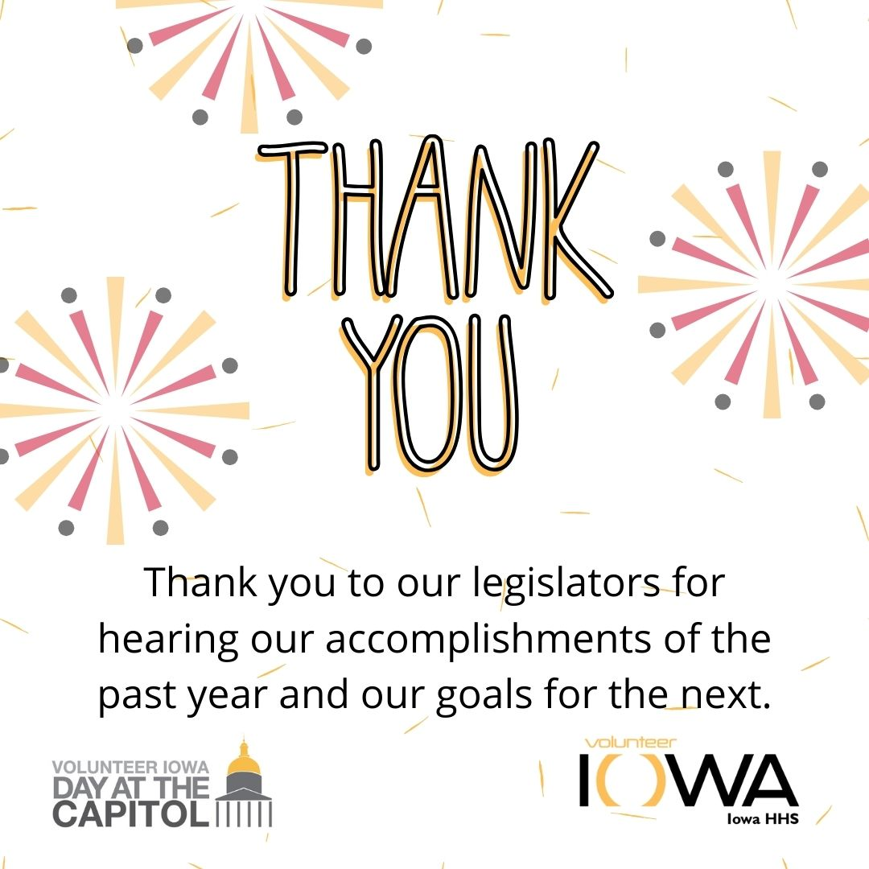
After Feb 1 1. Send a thank you email to the legislators you met with
2. Report back to volunteer Iowa on your meetings: 2024 Day at the Capitol After Action Report
3. Celebrate your participation on social media, your website, local news, etc. Check out our social media guide for template posts and graphics!
Your Role as a Participant
Notes:
Follow up with an email message to thank the legislators and to provide them copies of our materials and your own.
Complete the After Action report so we know who you connected with and any follow up needed.
Finally, let others know about your participation in the day. We’ve got messaging we’ll share with you for social media and can also help you with language for issuing your own press release or newsletter story.

Slide 10
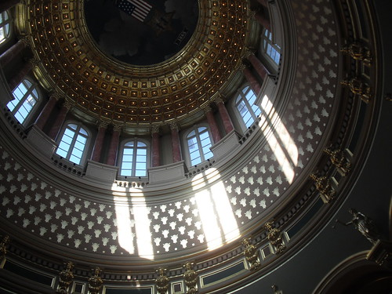
Understand how you can participate
EVERYONE can educate their elected officials about issues/programs that are important to them.
Many, but not all, can engage in lobbying.
Know your status at your organization (funding for your position, internal policies about lobbying)
AmeriCorps members may not lobby
Know the distinction between activities that count as lobbying and those that qualify as educating
This Photo by Unknown Author is licensed under CC BY
Notes:
We know that our network includes our federally-funded national service corps members and staff. It’s important for everyone to participate in our day but to do so as is allowable.
If you are unsure about limits for your position, ask your supervisor. (i.e. board members vs. federally/state-funded staff vs. AmeriCorps/Senior Corps members)

Slide 11
Education vs. Lobbying
Educating
If you are communicating the issues by informing legislators of your program successes, along with the need and demand for services, then you are educating your legislators on the issues. (National Coalition for Literacy)
Lobbying
If you are combining that information with a request for action on specific legislation, whether for legislative language or funding, (the issues plus the ask), then you are lobbying. (National Coalition for Literacy)
Advocacy: a general term;
some advocacy would be considered lobbying, other advocacy would be considered educating.
Notes:
The distinction between educating and lobbying has to do with the ask.
IRS rules limiting nonprofit lobbying activity are basically to prohibit an organization from forming for the sole purpose of lobbying under the guise of a nonprofit. There is not a ban on lobbying by nonprofits.
AmeriCorps/Senior Corps members and staff paid 100% out of federal funds cannot lobby during their service/work hours. Program alums may do so (in their capacity as alumni) and members/staff may lobby on their own time.

Slide 12
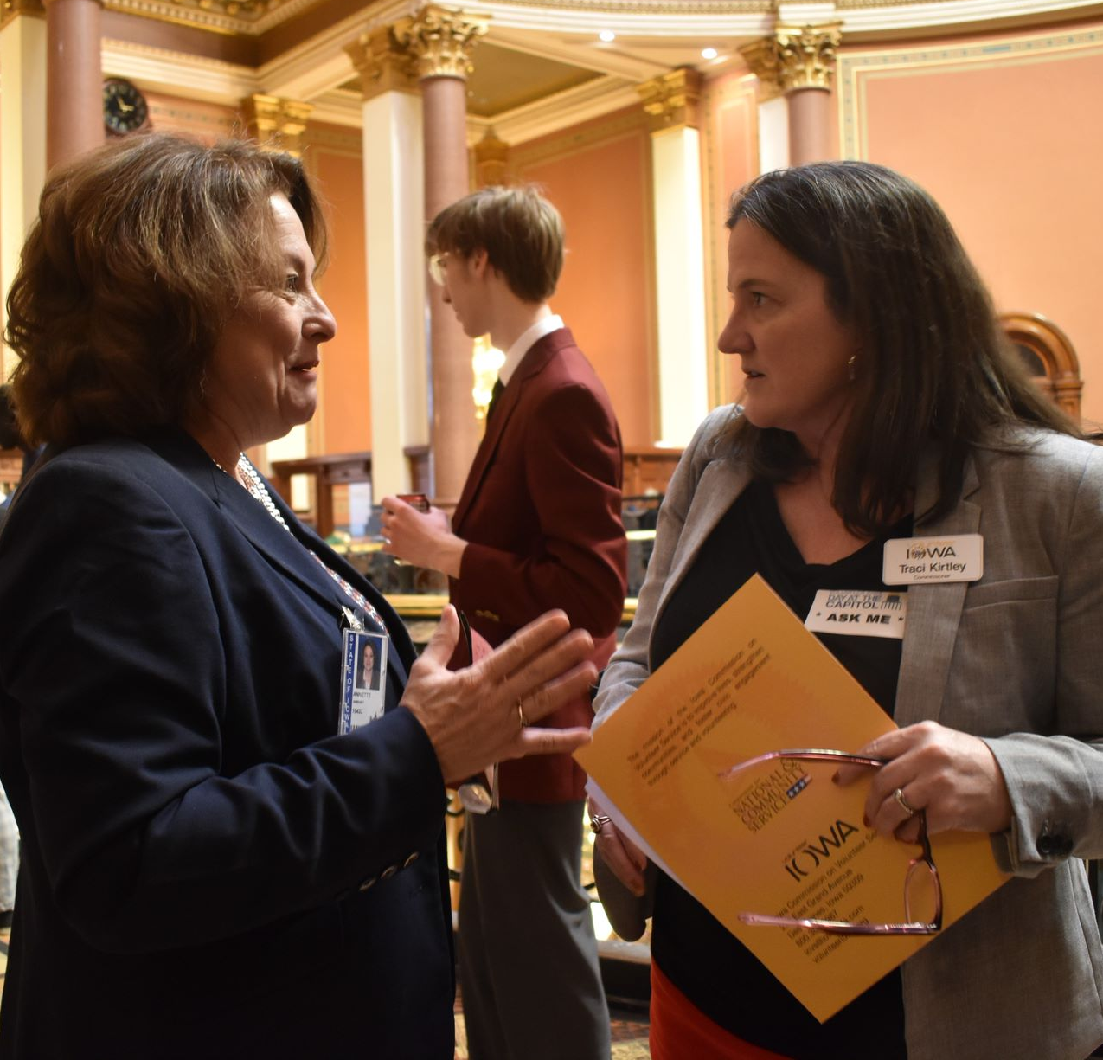
Tips for talking to Legislators
Introduce yourself, your hometown or county, and who you represent
Be brief, specific and practical; make the connection to the legislator’s district. if you have an “ask” make it quickly
Consider yourself a consultant to legislators; you have expertise and insights that can help them
Ask the legislators to support your program or your goal
Leave behind brief handouts. highlight important information. include your contact info
Ask if it is okay to take a photograph; Share on social media and tag @volunteeriowa
Thank the legislators
Notes:
Rebecca Introduce Kevin Koester, Volunteer Iowa Commissioner and Former Legislator (Iowa State Representative, 38th District (2009-2018))
KEVIN
Cautions:
Be mindful not to overwhelm with too much information or jargon
It’s okay to say you don’t know something and offer to find the answer to a question and send it back. Then, be sure to follow up!
Don’t expect legislators to be specialists, they work with a lot of bills and have busy schedules – be specific with the legislation or policy you are talking about
Don’t confront, pressure or beg
Adapted from Materials edited from Lobbying Lawmakers A How-To for Non-Profit Organizations Audio Conference Guide; CD PUBLICATIONS Silver Spring, MD www.cdpublications.com

Slide 13
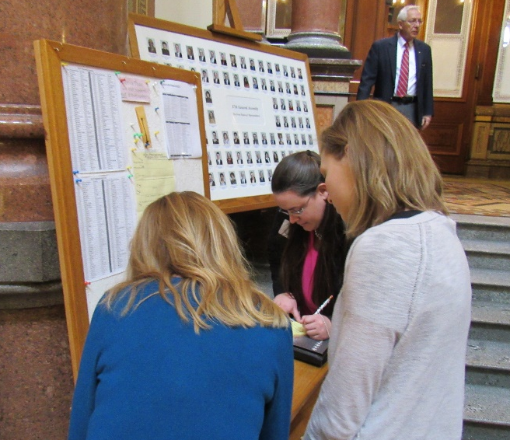
Key Strategies
Develop an agenda and strategy
Use the Volunteer Iowa toolkit
Contact in advance
Combine data with personal stories

Slide 14
After Action Report
Who you meet with
Topics discussed
Questions for Volunteer Iowa
Suggestions for Volunteer Iowa
Plans for continued engagement
Sent through Survey Monkey
Notes:
We ask that all participants complete a short report of your activities for our records. This helps us understand how the day went and who was reached. This link is available in the toolkit, will be posted in the chat for this meeting, and will be sent out after the event.
Link:
https://www.surveymonkey.com/r/ZHM6RRP

Slide 15
Continued Engagement
Send elected officials your newsletters and Press Releases
Follow them on social media, invite them to follow your organization
Invite leaders to visit your program
Ask for support for Days of Service (MLK Jr. day, 9/11)
Notes:
Reminder that this is hopefully the start of your engagement with your legislators- continue to build the relationship with opportunities to engage with our work

Slide 16
2023 Highlights and 2024 Priorities
“It was truly an amazing experience that helped answer a lot of questions that I had about local civic government and civic engagement. I will definitely be much more willing to reach out to my local representatives in the future.”
over 90 unique contacts
representing metro areas and statewide programs
emails, in-person meetings, and calls
“It is empowering when effective training is provided.”
“This was my first legislative event and I felt very prepared and ready to speak to representatives.”

Slide 17
2023 Key Volunteer Iowa Accomplishments
National Service
Over 7,800 AmeriCorps Seniors & AmeriCorps members served in the last program year
Community Volunteerism
Nearly 73,000 volunteers are leveraged annually by Volunteer Iowa
Mentoring
Over 6,000 youth are served annually by a mentor in 52 local program partners of Iowa MENTOR
Over $3.4 million in Segal education awards awarded to AmeriCorps members
More than $29 million in federal funding invested to support cost-effective community solutions
More than $7.1 million in outside resources leveraged from businesses, foundations, public agencies, and other sources in Iowa last year
Since 1994, more than 14,000 Iowa residents have served 19 million hours, earning education awards totaling more than $48.2 million
Volunteer Iowa’s statewide database supports nearly 1,800 organizations in finding volunteers
In 2022, 57.6% of Iowans volunteered regularly according to a statewide survey (BRFSS)
Volunteers provided service worth $1.3 billion in labor to Iowa charities and communities keeping them afloat while meeting a bigger demand
Iowa's informal volunteer rate ranks 9th highest in the country
42 youth-serving programs meet national standards of the National Quality Mentoring System through the National Mentoring Resource Center
Iowa MENTOR has program partners covering 66 counties
81% of participants in Iowa mentoring programs have met program goals
Notes:
To remind you of our highlights in these 3 buckets of work.
Highlight a few of them:
7,800 ac members serving iowa
$1.3 billion volunteer value and 57.6% volunteer rate
6k youth have a mentor because of iowa mentor
This will also be in the VI one-pager that we provide for you.

Slide 18
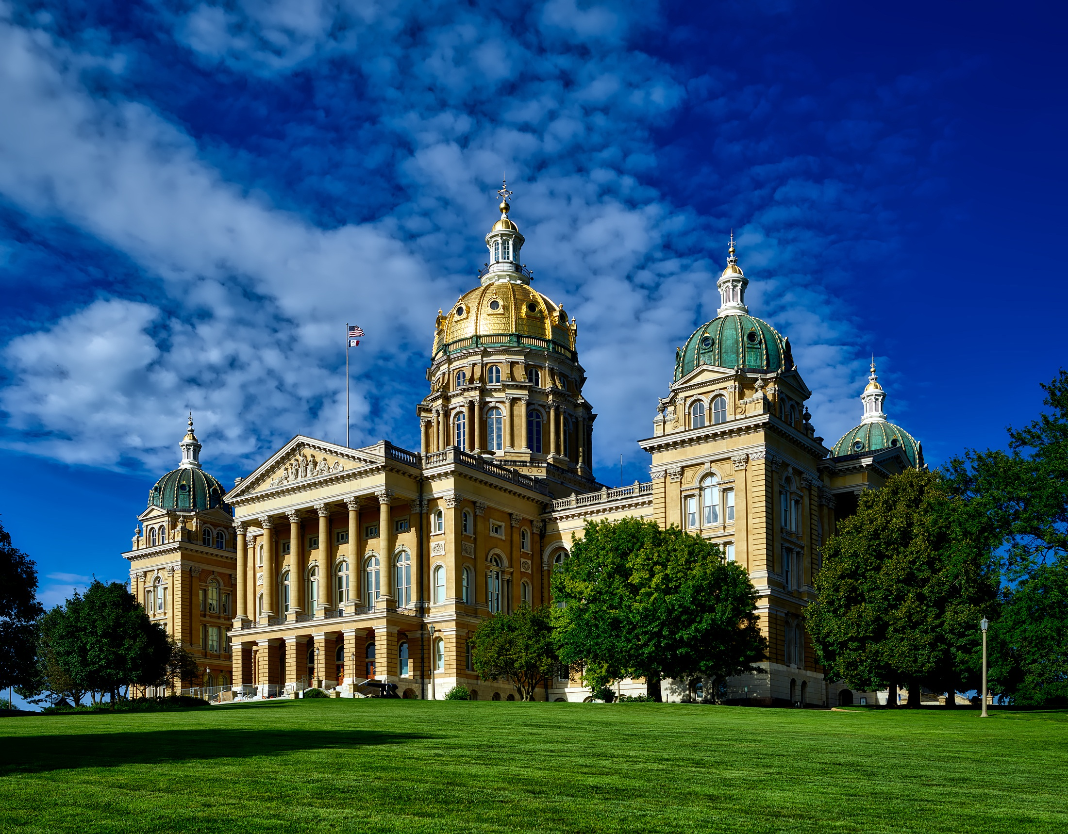
Volunteer Iowa Policy Priorities
We advocate for policies that:
Build the culture and climate for service in Iowa
Support the infrastructure needed for quality service opportunities and programs
Develop new service opportunities to meet critical community needs
Improve and streamline existing service opportunities and programs
Expand Iowa's existing volunteer base
Notes:
Volunteer Iowa has drafted the following principles that guide our public policy work. From these, we develop a yearly agenda of policy goals.
Basically the commission supports policies that will foster a culture of service by remove barriers and fostering growth.

Slide 19
Legislative Priority: Provide sufficient state funding to maintain support for all federally-awarded Iowa programs ($418,698). Annual RSVP state funding is awarded in the Health and Human Services (HHS) appropriations subcommittee (transfer from Dept. on Aging Appropriation).
Impact: In 2022-2023, over 3,800 RSVP volunteers served Iowa communities, contributing over 222,000 hours to support community needs such as disaster relief, financial literacy, and food security, at a value of $5.8 million.
Notes:
Volunteer Iowa administers state funding that is provided to RSVP programs. While at this time there is not a state appropriation for other AmeriCorps Seniors programs, we hope that all will support our legislative priority for this year.
The commission is requesting status quo funding in line with the governors budget

Slide 20
AmeriCorps Tax Burden
Legislative Priority: Exempt the AmeriCorps living allowance from state income tax.
Impact: AmeriCorps members have a tremendous impact, both directly and by leveraging additional volunteers (15,663 in 2022-2023), yet their compensation is little over the poverty level. Removing the income tax burden would help recruit and retain high-quality members. Tax proposals will be considered by the Ways and Means committees.
Iowa National Service Corps
Legislative Priority: Dedicate funding towards expanding the Iowa Reading Corps and/or formalize role of master coaching with AEAs and maintain appropriation for RefugeeRISE AmeriCorps.
Impact: The Iowa Reading Corps program has been shown to help struggling students’ progress at 1.5 to 2 times the target rate. Funding and institutional efficiency would help expand the Reading Corps to rural areas. It is the currently the most cost-effective intervention.
Notes:
The commission supports the Governor’s National Service Council recommendation of expanding tax benefit to living allowance so the state is not “charging people to serve”. Additionally we support efforts to grow targeted Iowa National Service Corps programs like reading corps and refugee Rise.

Slide 21
Legislative Priority: Maintain annual funding awarded for program grants in the Health and Human Services appropriations subcommittee (with Iowa Department of Public Health appropriation).
Impact: State funding supports grants to certified mentoring programs to connect young people with supportive adult relationships and provide specific substance abuse prevention training. Mentoring is an effective evidence-based prevention and intervention strategy with positive effects on school attendance, mental health support, violence prevention, and workforce development.
Notes:
Volunteer Iowa houses Iowa MENTOR supporting youth-serving mentoring programs.
The Commission supports the governors budget to maintain Mentoring appropriation. Iowa MENTOR certified programs receive over 700k in grant funding earmarked by public health. Letting legislators know about that and the benefit of it is critical. Additionally Iowa Mentor receives about 100k in direct appropriation to support its work as part of commission appropriation. Both are critical to support mentoring.

Slide 22
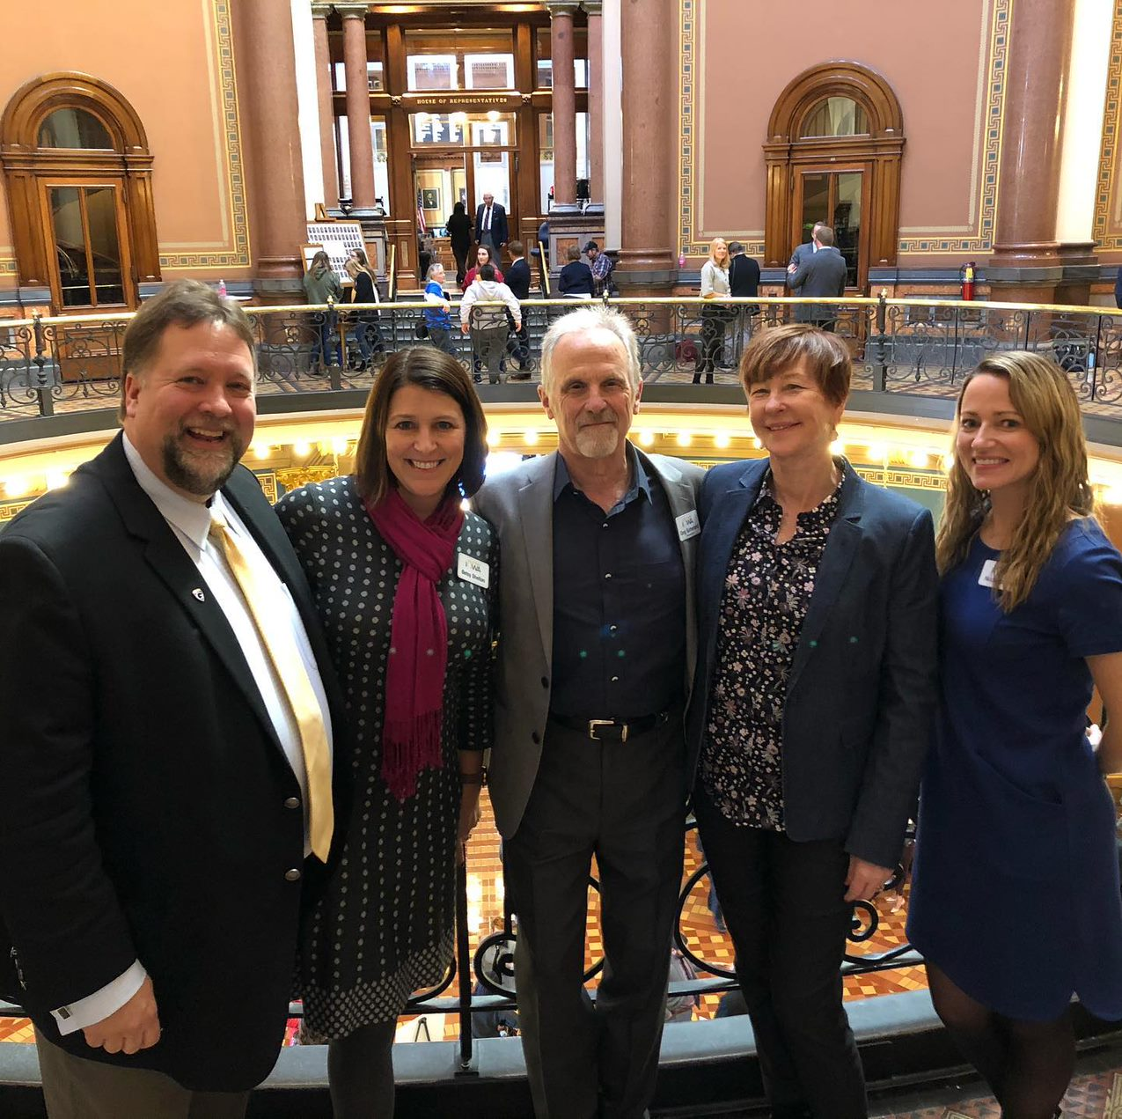
Thank you!
If you have further questions, contact Volunteer Iowa staff:
info@volunteeriowa.org
1.800.308.5987

